Slide 1



LT – THE TRAVEL INDUSTRY PERSPECTIVE
LT-INNOVATE SUMMIT 2013
Towards the Multilingual Digital Single Market
26-27 June 2013
Carlos Romero Dexeus
R&D&i Director

Slide 2
FACTS
Travelers have never had higher expectations, while destinations across the World are offering ever more complex and tailor-made services and experiences….and LT are key facilitators.

Slide 3
DRIVERS
1. A fierce competitive environment at service and destination levels.
2. Internet is the place where most the decision are taken.
3. Increasing diversification (types of travelers & touristic experiences).
4. Changes in tourism preferences (looking for new experencies).

Slide 4
DRIVERS
5. Increasing price-driven last minute decisions.
6. Consumers have never needed more help in choosing travel products
7. Industry players are embracing social and engagement technologies
8. Increasing use of Social Networks planning (find, compare and review)

Slide 5
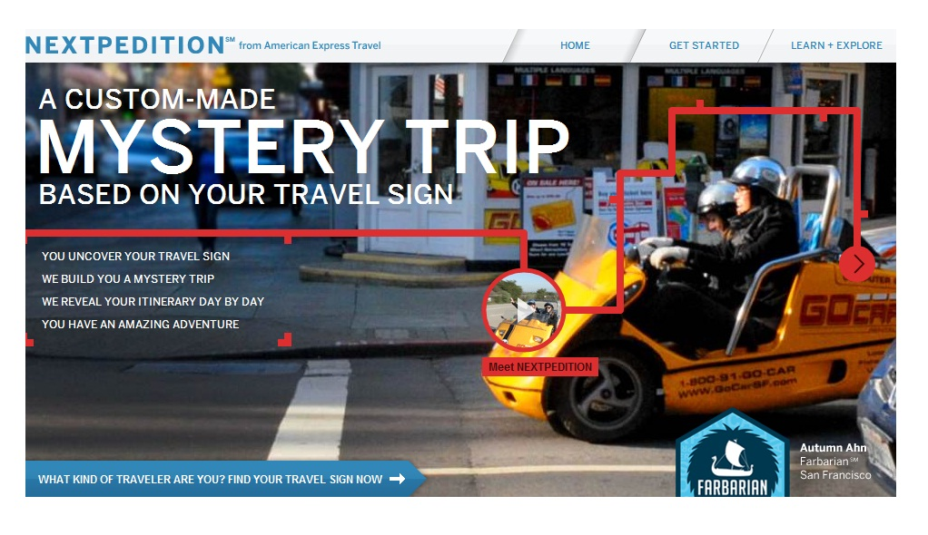
CHALLENGES
More cost-efficient and engaging ways to deliver relevant and customized contextualized content in mobility
Notes:
Personal: as consumers start to receive or see only local information that is relevant or interesting to them personally.
– Timely: with more consumers (constantly) contributing to the real-time content avalanche, out-of-date information will be a thing of the past.
– Effortless: expect consumers to truly appreciate the endless, easy ways of being alerted to information, events, offers or people of interest.

Slide 6
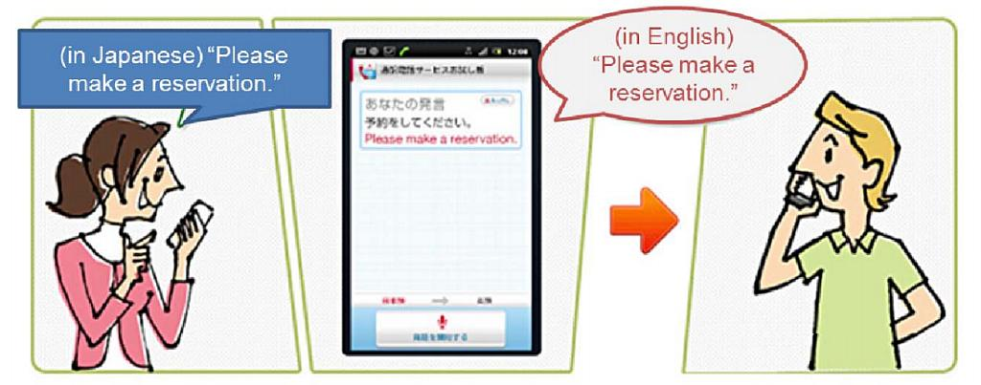
CHALLENGES
Customizing products and services to different cultural segments in their languages
http://www.nttdocomo.com
Notes:
Available in Japan from November 2012, NTT DOCOMO's free Hanashite Hon’yaku app offers real-time translation of phonecalls. Users select a contact through the app if they will be talking to a foreign language speaker, and Hanashite Hon’yaku then automatically detects what languages are being spoken before providing instant text translations. Users can see on-screen text translations or have the voice engine provide an audio version. The app can also be used to translate speech in a face-to-face conversation by getting both parties to speak close to the phone. At launch, languages available included Japanese, English, Chinese or Korean.
Link: http://www.nttdocomo.com/pr/2012/001611.html?x=20&y=15

Slide 7
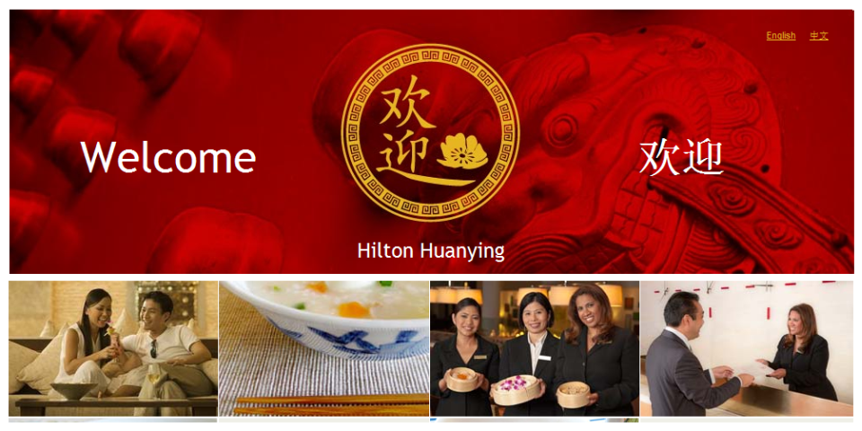
CHALLENGES
Customizing advertising, online marketing strategies, webs, brand tracking in the required languages
Notes:
In July 2011, Hilton Worldwide launched its “Hilton Huanying” service. Chinese guests can check-in in their native language and benefit from in-room facilities such as Chinese tea and television channels, as well as slippers and a welcome letter in Mandarin.
There’s also a breakfast buffet available, with congee, dim sum and fried noodles on the menu.
Link: www.hilton.com/huanying
Chinese residents made over 30 million overseas trips in the first half of 2011 alone, up 20% since 2010. By comparison, US citizens were only expected to make 28.5 million overseas trips by air during the whole of 2010.

Slide 8
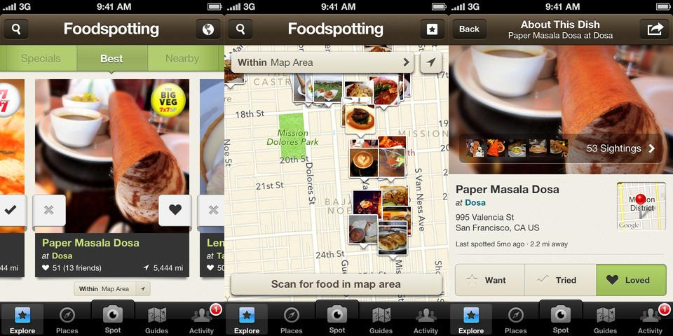
CHALLENGES
Detailed analytics enabling touristic product and service suppliers to understand customer needs better (CRM)
Notes:
May 2012 saw Foodspotting update its free mobile app to generate restaurant and menu suggestions based on consumers' personal tastes. When individuals launch the app, they can view images of dishes available at restaurants nearby, as well as Foodspotting users' reviews of these. Dishes can be sorted according to rating, and users can also view which meals their friends have enjoyed, and bookmark dishes for future reference.
Link: https://itunes.apple.com/gb/app/foodspotting/id350727118?mt=8

Slide 9
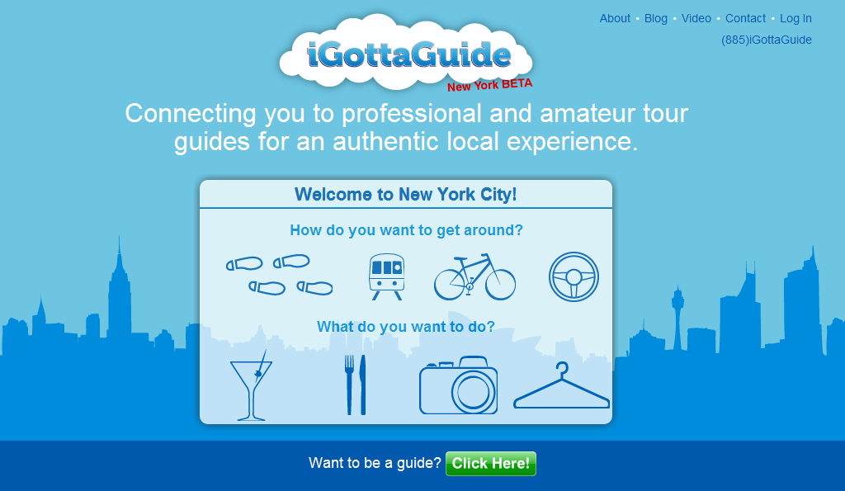
CHALLENGES
Increase role of recommendations and local knowledge to provide and
Notes:
Launched in June 2011, US based iGottaGuide (http://www.igottaguide.com) connects tourists visiting New York to professional and amateur tour guides. Tour guides range from the professional offering premium experiences to simply New Yorkers with a hobby. Users only pay for services after the tour is completed and the service is free to join for both parties with only a 15 percent fee applied to completed transactions, payable by the guide. Each tour is reviewed by previous attendees and users are encouraged to share their experiences with friends on social networks. Users who rate their experience and recommended a paying customer to iGottaGuide receive a USD 10 credit voucher towards their next booking.

Slide 10
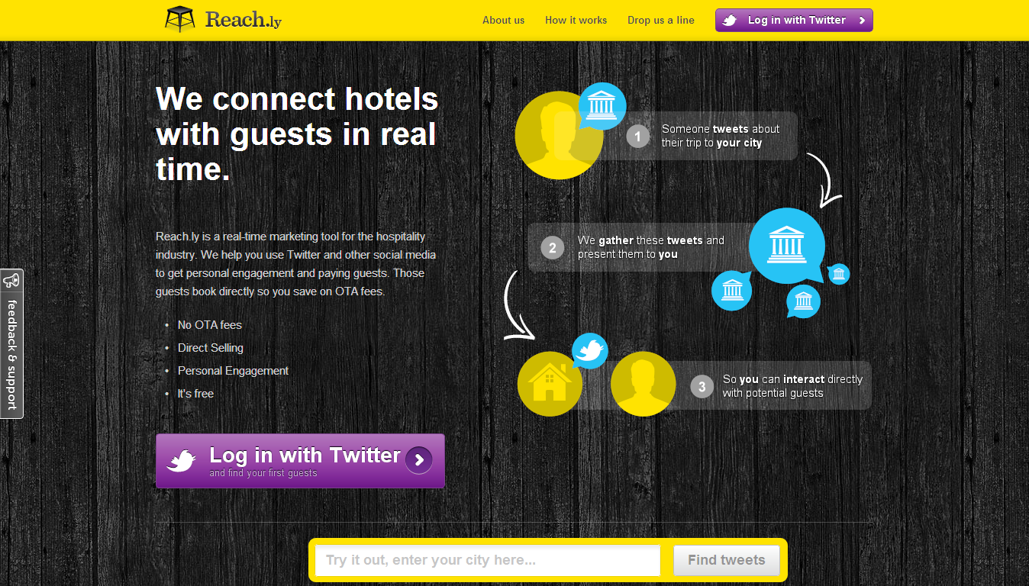
CHALLENGES
Optimize content thorough data harvesting in the new social cannels, an opportunity for new services
Notes:
Launched in August 2011 by Latvian software developers SIA Eklinda, Reach.ly (http://reach.ly) helps hotels to find new guests by monitoring Twitter for mentions of planned trips. Reach.ly's free service begins when hotels register with the site via Twitter and indicate which cities they're interested in; the tool then filters Twitter traffic, presenting a neatly packaged and manageable number of tweets from consumers who express an interest in traveling to that city. Hotels can communicate with potential guests through the Reach.ly interface, whether by sending a greeting, offering some advice about the city or extending a targeted offer.

Slide 11
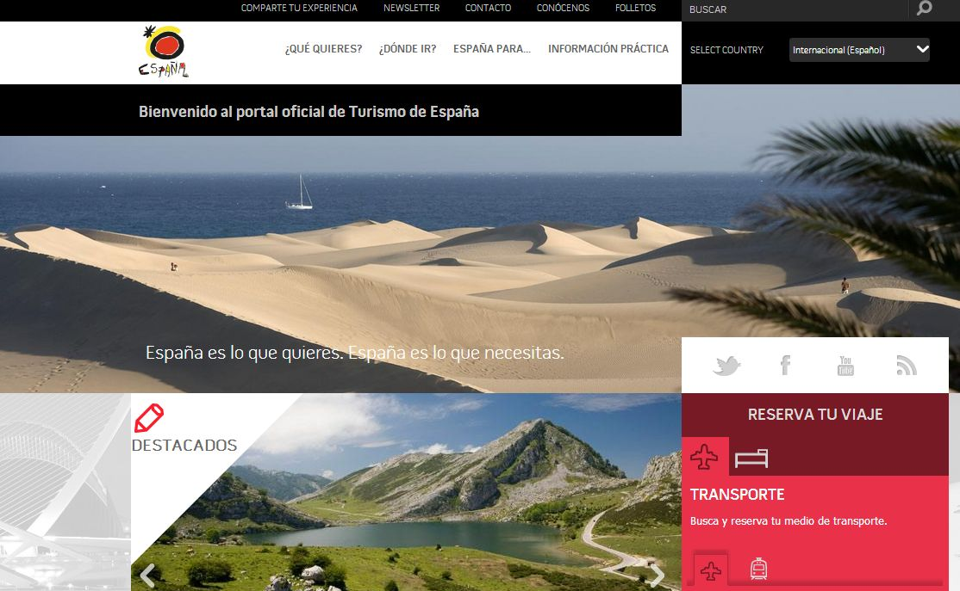
CHALLENGES
Translation is a constant concern in Tourism (cost, quality, timely, locally adapted, multiplatform, tags,..)
www.spain.info

Slide 12
BACK TO THE FUTURE
LT should allow us to provide opinions & analyse preferences: building conversations with my tourist.
Voice would be the future link with travelers
Much better cultural
Interoperability
Further interaction between LT and CRM solutions
Georeferenciated language analysis
Translation should support non-verbal communication ☺☹
“my personal guest dictionary” as a segmentation tool
M2M “let my device to talk with yours and plan my holidays”
More and more language & sentiment analytics

Slide 13



+ 34 91 443 07 07
Carlos.romero@segittur.es
@carlosromerodex
www.segittur.es

