Slide 1
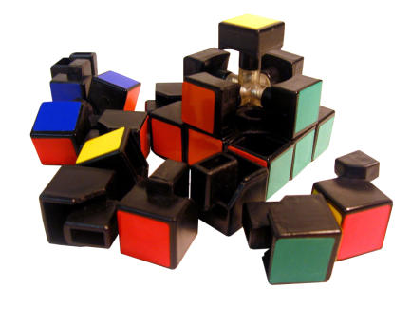
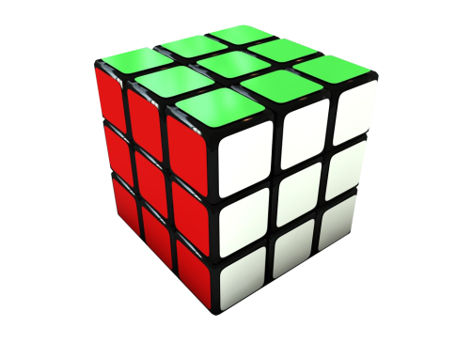
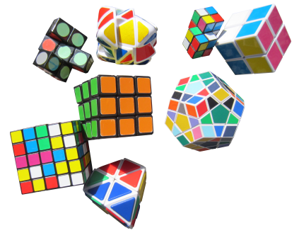
Knut Haga on the status of the LT industry
Fragmented
Is it an industry – or just separate bits of something to become an industry?
LT report - focused on technology
Dictionaries / translation / text to speech SW /tech / IT /linguistics
Are we an IT/SW industry or a service industry?
The value-chain – unclear
From invention to production and delivery
Who are the end-users?
A person (B2C or person)
An organization (B2B)
The LT industry needs to bring the assembled cubes to the market
Notes:
The industry is fragmented. Difficult to identify it in the general landscape.
Not a clearly defined industry.
Is it part of IT/SW industry or is it a service industry?
Many players - many enabeling elements words/translation/speach – SW / tech / IT / linguistics / text
The vast blend of elements makes it difficult to define the industry and the value chain
Where / what or who are the users?

Slide 2
Knut Haga on the status of the LT industry
How to change
Create a clear defined industry structure
Define core LT service elements ”like the 6 colours in the cube”
Define which LT members covers what colour
Core elements ”colours”
Define future core elements
Language
Language corpus (akademia)
Language search processing / stemming
Technology
SW
translation
Text to speach
HW
Infrastructure
Program language in the infrastructure
Provision of services
Notes:
The industry is fragmented. Difficult to identify it in the general landscape.
Not a clearly defined industry.
Is it part of IT/SW industry or is it a service industry?
Many players - many enabeling elements words/translation/speach – SW / tech / IT / linguistics / text
The vast blend of elements makes it difficult to define the industry and the value chain
Where / what or who are the users?

