Slide 1
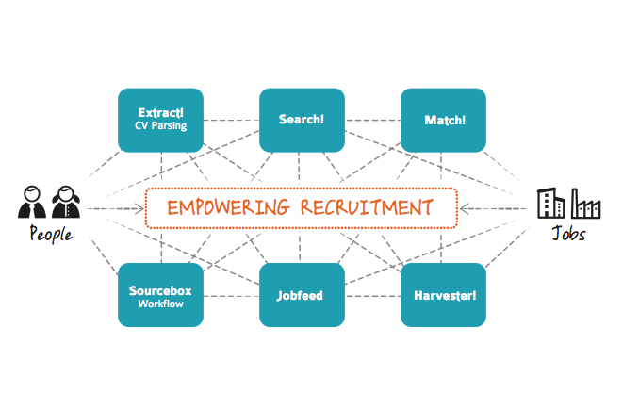
Semantic Recruitment Technology to power the European job market
Textkernel
Jakub Zavrel, Founder & CEO

Slide 2
Textkernel:
Spinoff from R&D in machine learning and language technology
Founded 2001, offices in Amsterdam (HQ), Frankfurt, Paris, 40 employees; strong R&D focus
Management owned: Jakub Zavrel (CEO), Gerard Mulder (CCO), Remko Bonnema (CTO), Joost Verschoor (COO).
Deloitte Fast 50 2007, 2010. 2013 target >4M€ revenue.
Core technology advantage:
Understanding unstructured text data.
Global competitive advantage: multi-lingual
Market:
Job boards, Recruitment Software, Staffing and recruitment, Mobility, Large Employers
Recurring (SaaS + on premise) license income:
  Multi-lingual tools (15 languages) to extract CVs and jobs
  Jobfeed: largest real time DB for job market analysis (NL, DE, FR, IT)
  Search! & Match! to connect people and jobs (EN, FR, DE, NL)
Customers: UWV, Pole Emploi, CBS, Adecco, Randstad, Monster, Stepstone, Axa, Philips, Robert Bosch etc. (350 direct, 2000+ indirect),
Large partner network (HR & recruitment software) 50% of sales

Slide 3
Lessons Learned from Textkernel
Multi-lingual product development costs
  Start a new product with 1 x innovation cost, add 20+ x language cost
  Machine Learning is a great technology basis
  Re-use of general resources for specific applications is limited
  Basic language resources not easily available for startups.
  - no recognition by R&D tax incentives, hard to finance from customers, banks, and investors
  - for SME’s in Europe a huge barrier to fast roll out
Skills shortage
  Western/Northern Europe
  Engineering, Computer Science, Software developers, Language Technology:
  - Invest massively in Technical Education + R&D!
  - More encouragement of labor mobility (internal and external to EU)

